Slide 1
Used Car Price Prediction Competition

Slide 2

Introduction & Problem Statement
● Car price prediction is a somehow an interesting and popular problem.
● car usage is increased by 2.7% since 2013 and it is likely that this trend will continue, and the number of cars will increase day by day.
● Accurate car price depends on many distinctive features and factors.
● A model to predict the price of a used car should be developed in order to assess its value based on a variety of characteristics. Several factors affect the price of a used car, such as company, model, year, transmission, distance driven, fuel type, seller type, and owner type. As a result, it is crucial to know the car's actual market value before purchasing or selling it.
“Price is what you pay, Value is what you get” - Warren Buffet

Slide 3
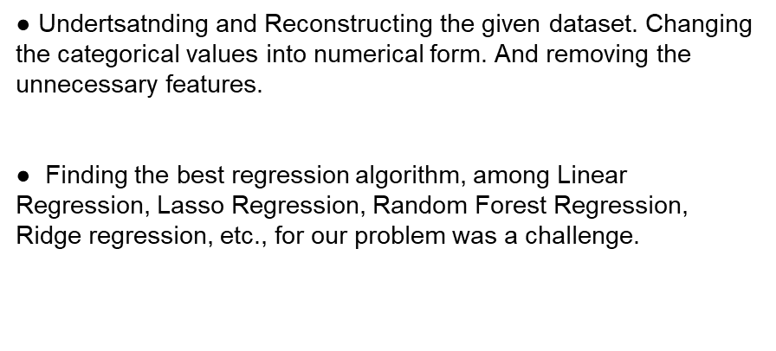


Slide 4
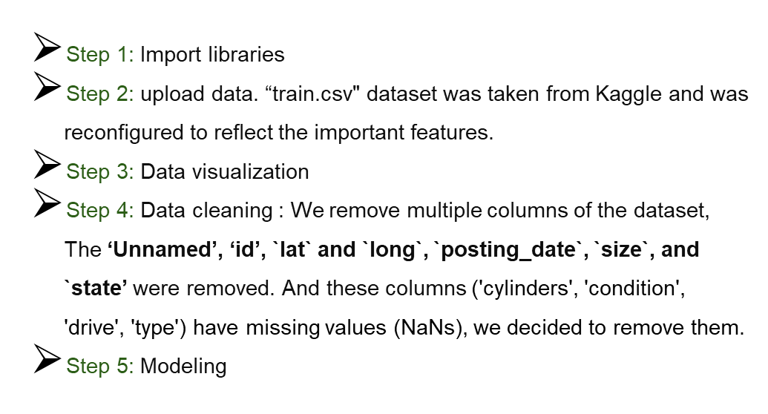

Slide 5
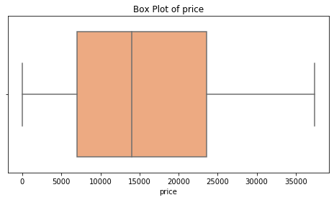
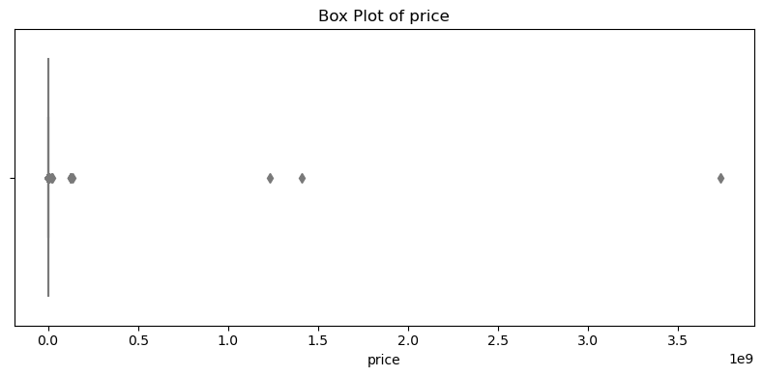
Price Outliers
Data Reprocessing
calculates the Interquartile Range (IQR) and upper and lower bounds for outlier detection for a Price column
Before
After

Slide 6
Condition column
- The missing values in the condition can be found using mean value of odometer as mileage affects condition of car.
Like new average odometer: 89585.31
Excellent average odometer: 109971.1
Good average odometer: 90170.23
Fair average odometer: 212998.09
Salvage average odometer: 243675.63
- sets the 'condition' to 'new' for those rows where the 'year' is greater than or equal to 2019 and the 'condition' value is missing (NaN).
- fills in the null condition values based on the car's odometer reading and the average odometer values for each condition.

Slide 7
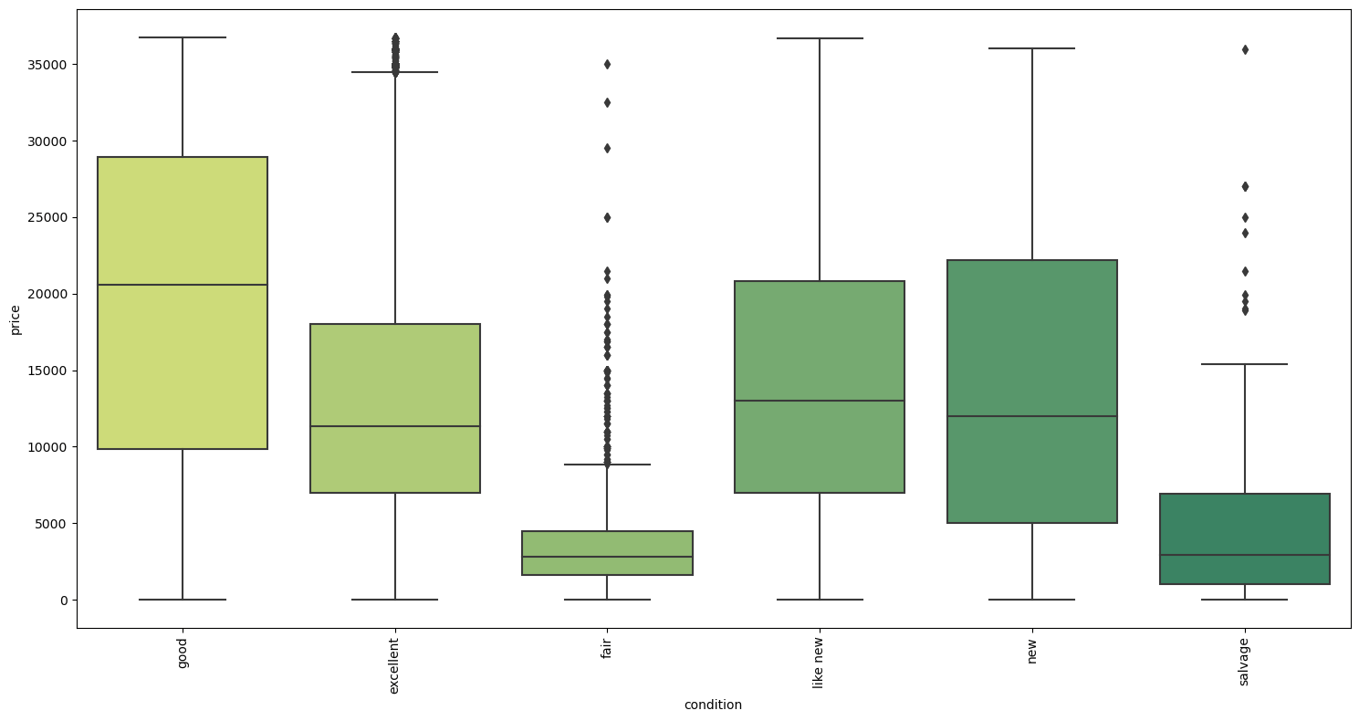
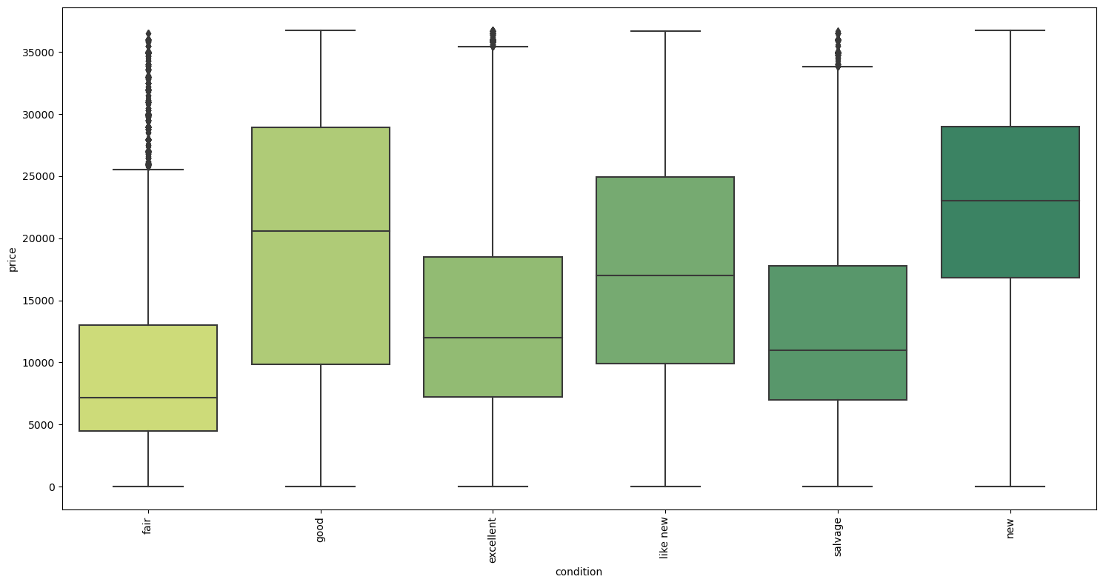
Before
After

Slide 8
Manufacturer column
checks if each element is one of the top 20 most frequent manufacturers, and keeps the original manufacturer name if it is in the top 20.
If the manufacturer is not in the top 20, it replaces the name with 'others'.

Slide 9
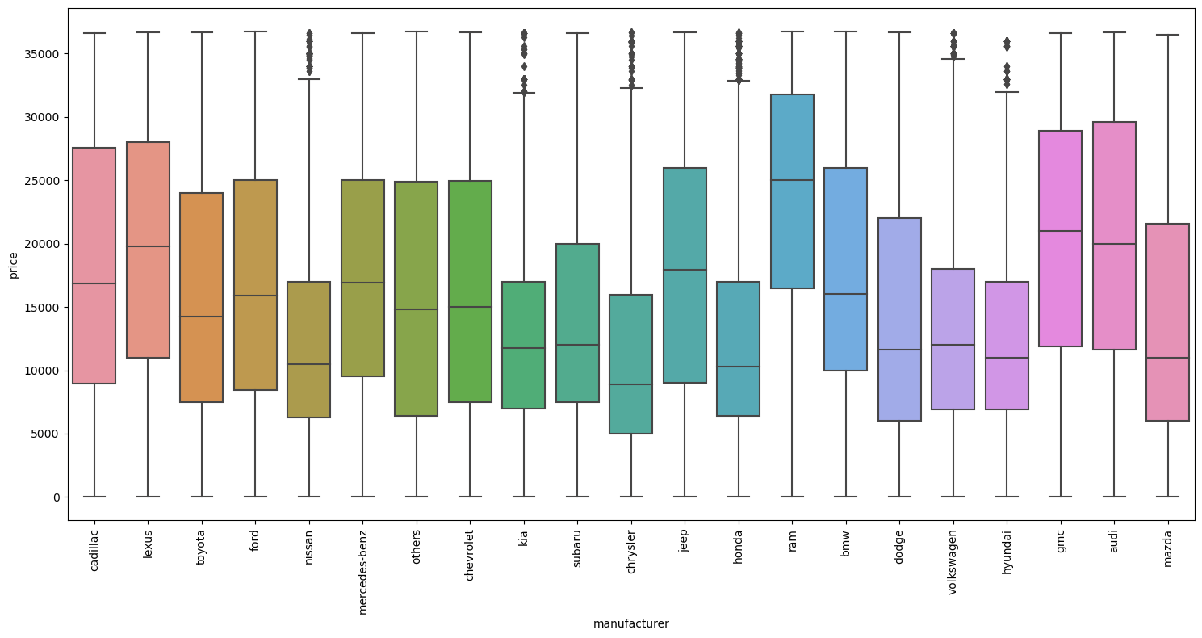
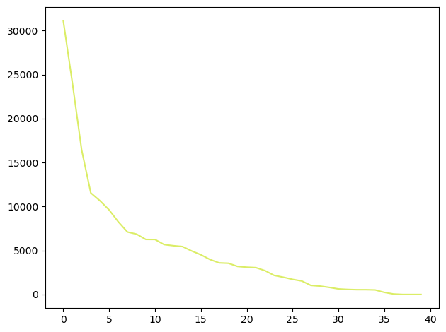
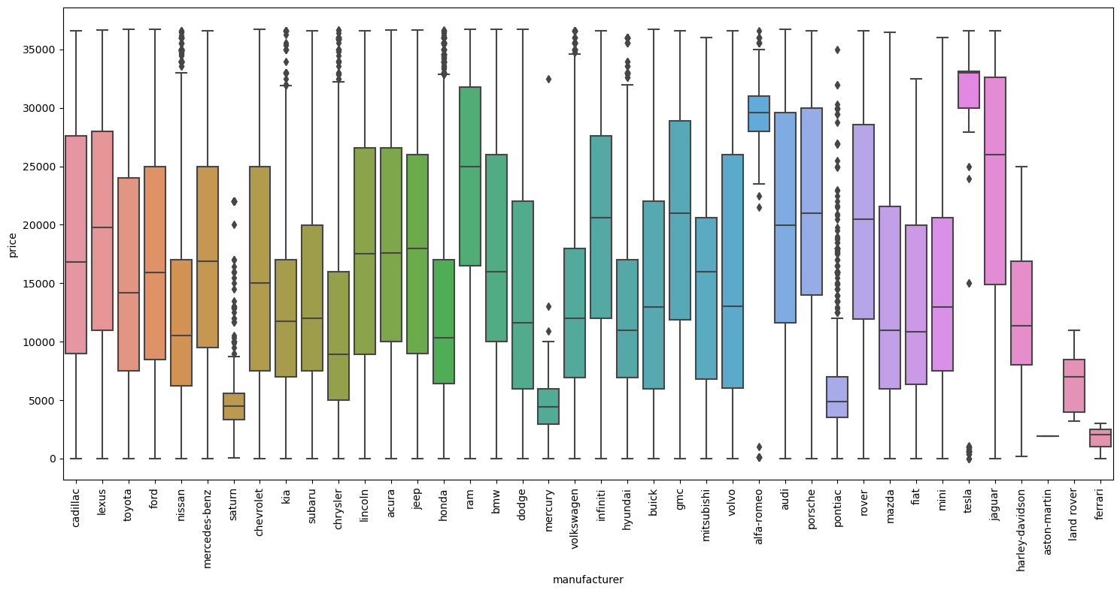
After
Before

Slide 10
Model column
Takes the ‘Model’ column in df, checks if each element is one of the top 50 most frequent model, and keeps the original model name if it is in the top 50.
If the model is not in the top 50, it replaces the name with 'others'.

Slide 11
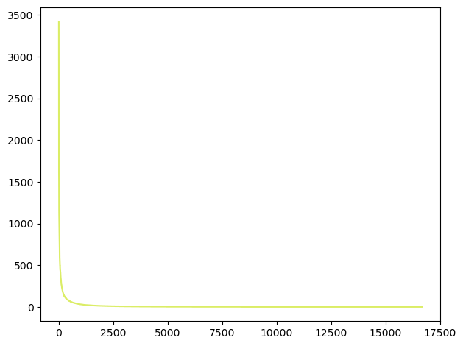
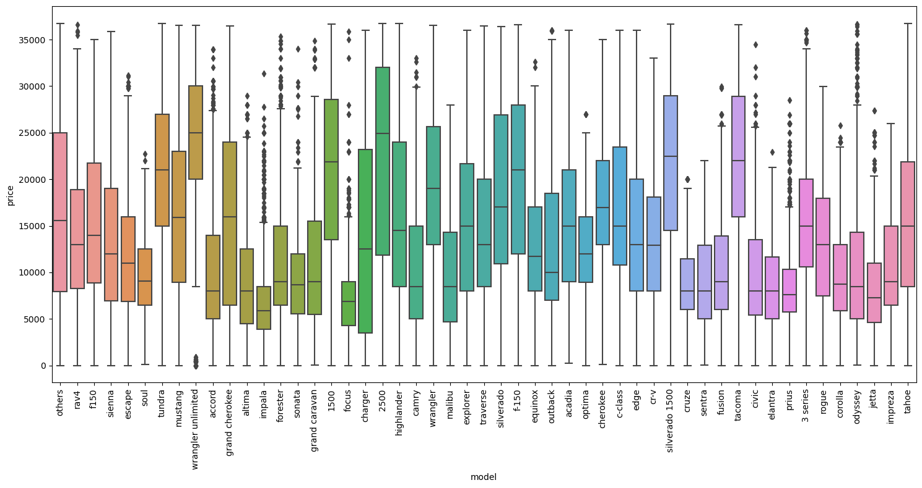

Slide 12
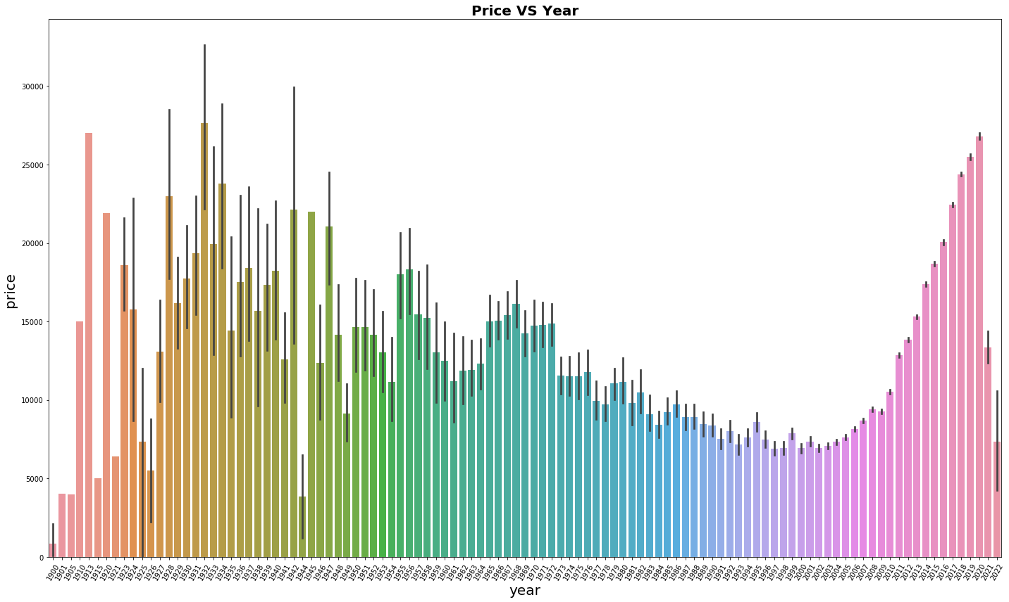
Year column
Take only rows where the 'year' is greater than 1996

Slide 13
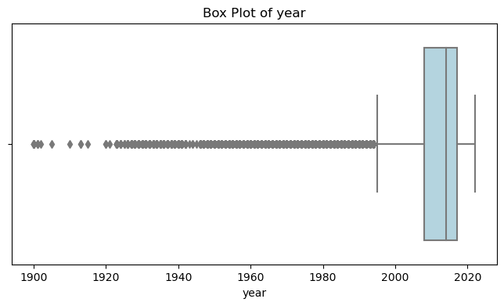
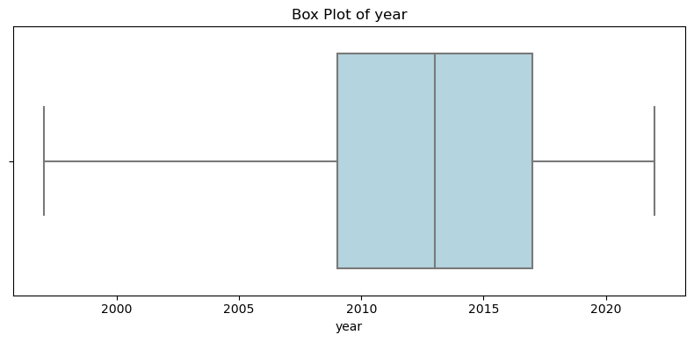
Before
After

Slide 14
Cylinders column
Changing cylinders of electric cars to other
takes the 'cylinders' column in df and categorizes the values. It keeps the original cylinder value if it is one of the top 9 most frequent cylinder values.
If the cylinder value does not match any of the top 9 values, it replaces the value with 'other'.

Slide 15
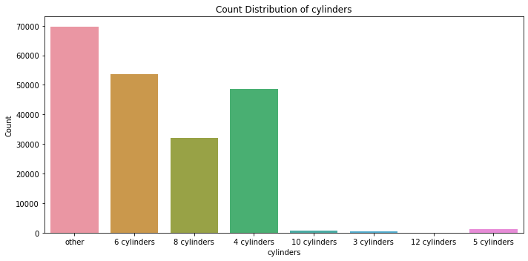

Slide 16
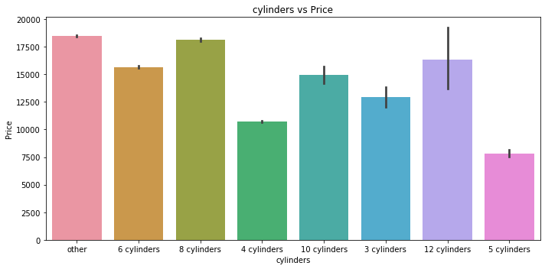

Slide 17
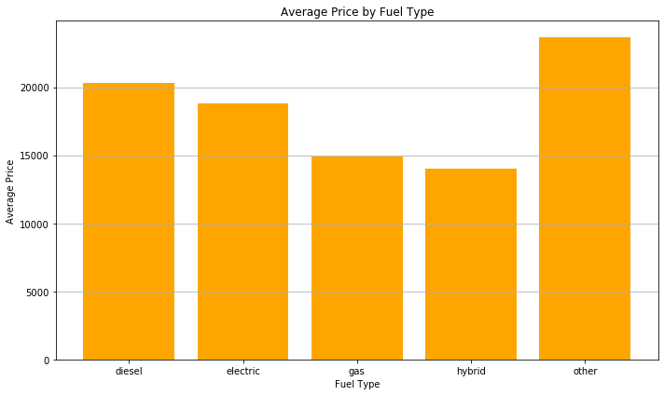
Fuel column
Group by manufacturer and model, then fill null values in 'fuel' with the corresponding non-null value

Slide 18
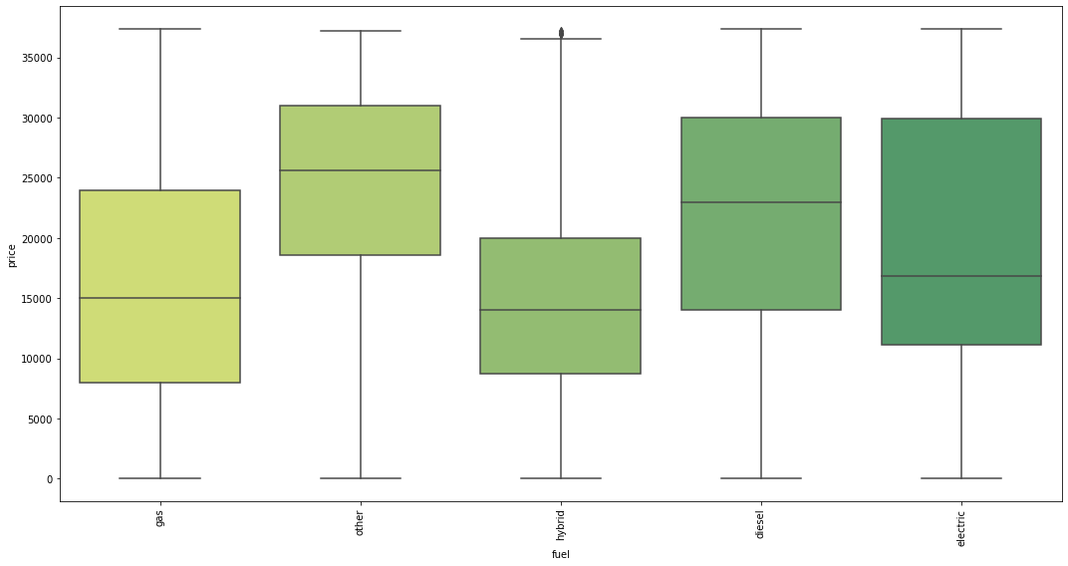
Fuel column

Slide 19
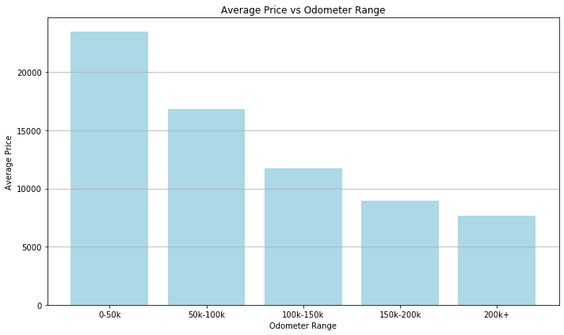
Odometer column

Slide 20
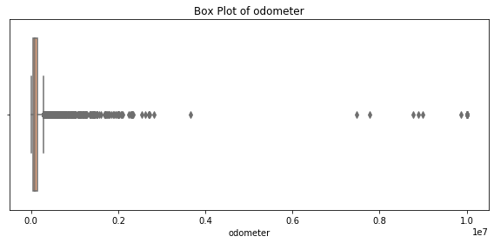
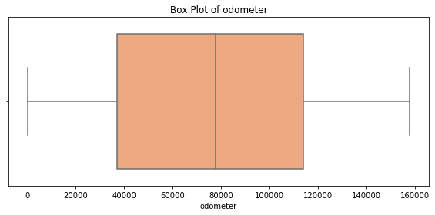
Odometer column
Before
After

Slide 21
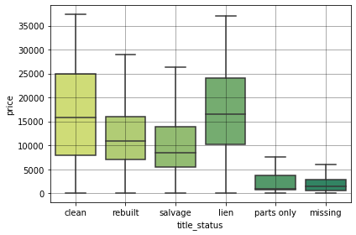
Title_status column

Slide 22
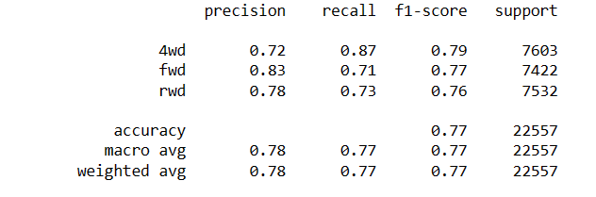
Drive column
- Create a model to predicting drive {4wd,rwd,fwd}
- Create dataset from our dataset
- Include all data that is not null at drive column
- Select the columns that we can see that it is affect the drive(target)
- Data up to 200000+ to predict only 3 values that's enough for that
- Drop all rows that contain NULL values
- Create RandomForestClassifier model

Slide 23
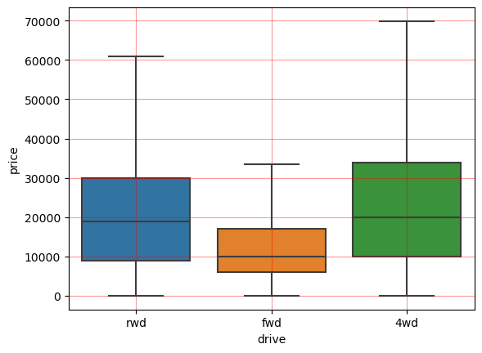
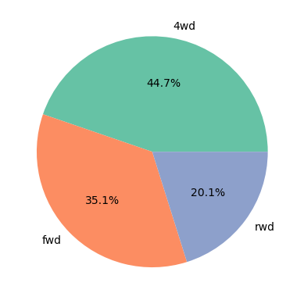
Distribution and the amount of each class

Slide 24
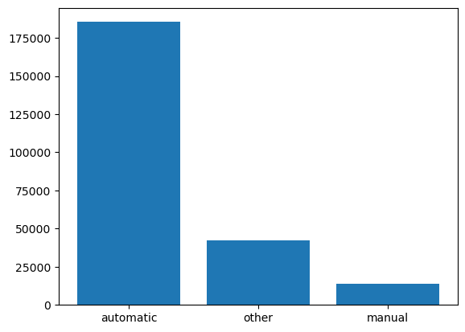
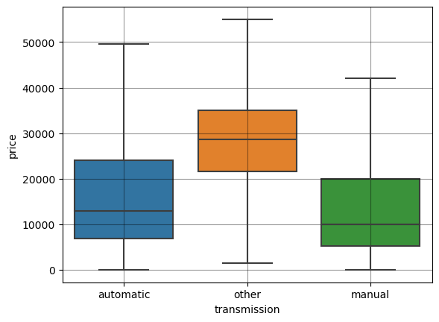
Transmission column:

Slide 25
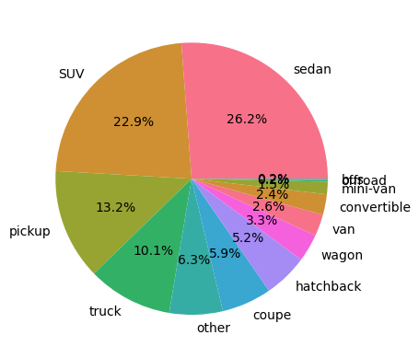
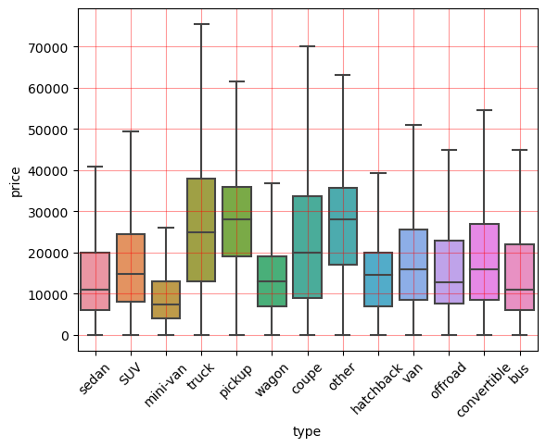
Type column

Slide 26
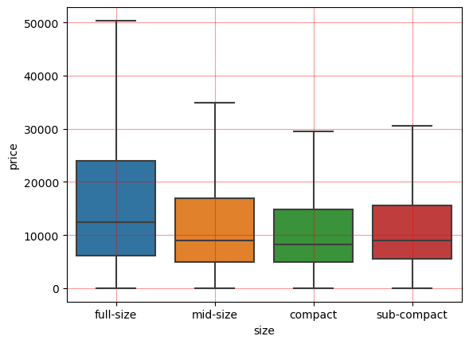
Size column
Without any affect on price.
Each size can be represented by other class
It makes model confused because models score Increases when we drop it

Slide 27
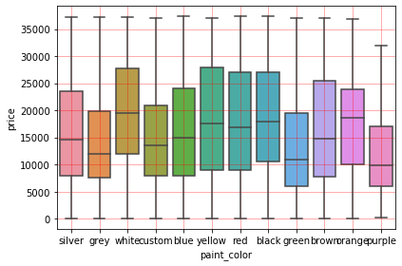
Paint color column

Slide 28
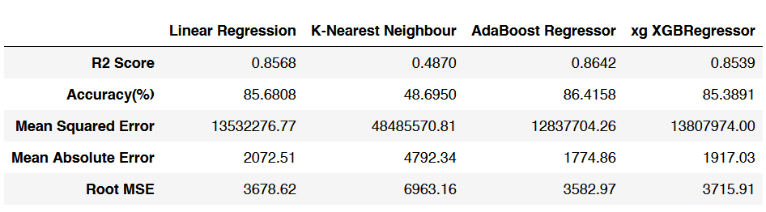
Modeling results – before fine-tune

Slide 29
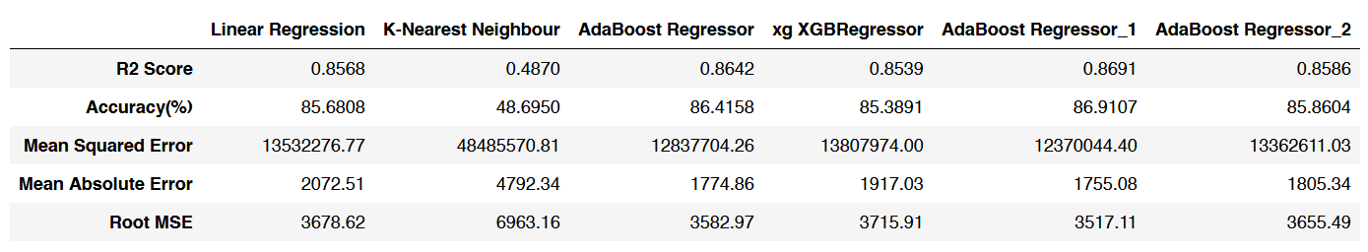
Modeling results – After fine-tune

Slide 30
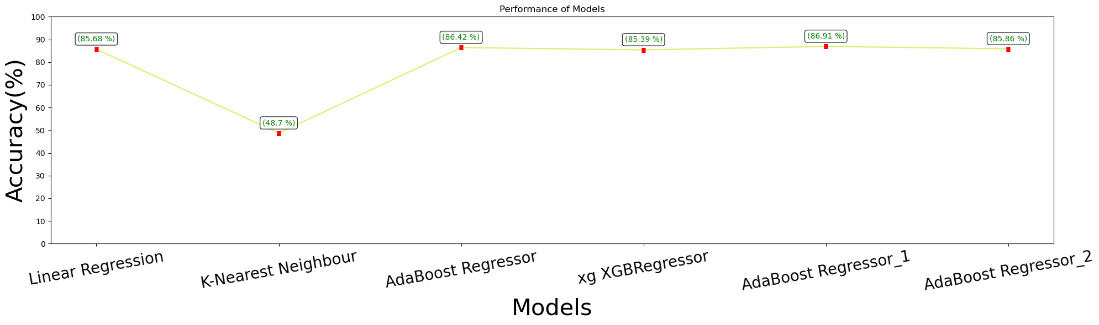

Slide 31
Github Project Link

Slide 32

Eman Azaizeh
Mahmoud Zubaidi
Muna Alsaber
Raneem Alomari
Eng. Hasan Aloqool
Eng. Haneen Alakhrass
Eng. Khawlah Alquran
THANK YOU!
“Predicting the future isn’t magic It’s Artificial Intelligence.”
-Dave Waters

